Slide 1
A click chemistry amplified nanopore assay for ultrasensitive quantification of HIV-1 p24 antigen in clinical samples
March 30, 2023
Chunlin Min

Slide 2
Outline
Background
HIV
Click Chemistry
Nanopore
Paper
Opinions

Slide 3
Background

Slide 4
Human Immunodeficiency Virus (HIV)
HIV is a virus that attacks the body’s immune system. There is no cure, but treatments are available to stop further progression of HIV
progression: Acute HIV -> chronic HIV -> AIDS
20% of new HIV infections are due to transmission from unaware infected individuals
Circulating RNA and antigen p24 are long recognized as significant biomarkers for HIV-1
Earlier studies suggest antigen p24 is a stronger predictor of progression to acquire AIDS than was RNA. However, proteins cannot be amplified like nucleic acid, which makes it challenging to achieve good sensitivity for p24 detection

Slide 5
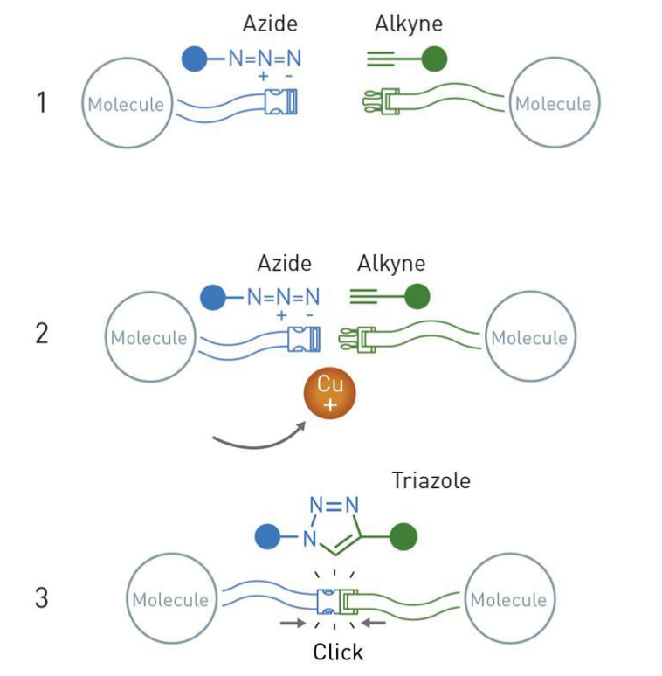
Click Chemistry
Convenient way of doing chemistry
Simple & no waste
Crown jewel of click chemistry: the copper catalyzed azide-alkyne cycloaddition
Widely utilized and reliable way of forming connections between different functional groups

Slide 6

Nanopore
Literally a nano sized pore on a membrane
The pore and membrane can be biological or solid-state
Principles
Apply a voltage across the membrane
Induced ion current is measured
Analyte passing through the pore causes current blockade (translocation event) and exhibits a unique signature
Analyte concentration correlate to frequency of translocation events
Challenges
Statistical in nature, requires at least nanomolar level of analyte concentration to operate practically
Direct application in complex clinical samples with interferent molecules

Slide 7
Paper

Slide 9
Opinions

Slide 10
Opinions?

Slide 11
References

